Slide 1
Data Structures & Algorithms
Week # 3: Searching Algorithms
Instructor Information:
Mr. INAM UL HAQ
Email: inamulhaq@imsciences.edu.pk

Slide 2
Searching Algorithms
Search for a target (key) in the search space
Search space examples are:
  All students in the class
  All numbers in a given list
One of the two possible outcomes
  Target is found (success)
  Target is not found (failure)

Slide 3
Searching Algorithms
Index:
0
1
2
3
4
Value:
20
40
10
30
60
Target = 30 (success or failure?)
Target = 45 (success or failure?)
Search strategy?
List Size = N = 5
Min index = 0
Max index = 4 (N - 1)

Slide 4
Sequential Search
Search in a sequential order
Termination condition
  Target is found (success)
  List of elements is exhausted (failure)

Slide 5
Sequential Search
Index:
0
1
2
3
4
Value:
20
40
10
30
60
Target = 30
Step 1: Compare 30 with value at index 0
Step 2: Compare 30 with value at index 1
Step 3: Compare 30 with value at index 2
Step 4: Compare 30 with value at index 3 (success)

Slide 6
Sequential Search
Index:
0
1
2
3
4
Value:
20
40
10
30
60
Target = 45
Step 1: Compare 45 with value at index 0
Step 2: Compare 45 with value at index 1
Step 3: Compare 45 with value at index 2
Step 4: Compare 45 with value at index 3
Step 5: Compare 45 with value at index 4
Failure

Slide 7
Sequential Search Algorithm
Given: A list of N elements, and the target
index ← 0
Repeat steps 3 to 5
3. Compare target with list[index]
4. if target = list[index] then
return index // success
else if index >= N - 1
return -1 // failure
5. index ← index + 1

Slide 8
Binary Search
Search through a sorted list of items
  Sorted list is a pre-condition for Binary Search!
Repeatedly divides the search space (list) into two
Divide-and-conquer approach

Slide 9
Binary Search: An Example (Key ∈ List)
Index:
0
1
2
3
4
5
6
7
8
9
Value:
5
10
18
30
45
50
60
65
70
80
Target (Key) = 30
First iteration: whole list (search space), compare with mid value
  Low Index (LI) = 0; High Index (HI) = 9
  Choose element with index (0 + 9) / 2 = 4
  Compare value at index 4 (45) with the key (30)
  30 is less than 45, so the target must be in the lower half of the list

Slide 10
Binary Search: An Example (Key ∈ List)
Second Iteration: Lookup in the reduced search space
Index:
0
1
2
3
4
5
6
7
8
9
Value:
5
10
18
30
45
50
60
65
70
80
  Low Index (LI) = 0; High Index (HI) = (4 - 1) = 3
  Choose element with index (0 + 3) / 2 = 1
  Compare value at index 1 (10) with the key (30)
  30 is greater than 10, so the target must be in the higher half of the (reduced) list

Slide 11
Binary Search: An Example (Key ∈ List)
Third Iteration: Lookup in the further reduced search space
Index:
0
1
2
3
4
5
6
7
8
9
Value:
5
10
18
30
45
50
60
65
70
80
  Low Index (LI) = 1 + 1 = 2; High Index (HI) = 3
  Choose element with index (2 + 3) / 2 = 2
  Compare value at index 2 (18) with the key (30)
  30 is greater than 18, so the target must be in the higher half of the (reduced) list

Slide 12
Binary Search: An Example (Key ∈ List)
Fourth Iteration: Lookup in the further reduced search space
Index:
0
1
2
3
4
5
6
7
8
9
Value:
5
10
18
30
45
50
60
65
70
80
  Low Index (LI) = 2 + 1 = 3; High Index (HI) = 3
  Choose element with index (3 + 3) / 2 = 3
  Compare value at index 3 (30) with the key (30)
  Key is found at index 3

Slide 13
Binary Search: An Example (Key ∉ List)
Index:
0
1
2
3
4
5
6
7
8
9
Value:
5
10
18
30
45
50
60
65
70
80
Target (Key) = 40
First iteration: Lookup in the whole list (search space)
  Low Index (LI) = 0; High Index (HI) = 9
  Choose element with index (0 + 9) / 2 = 4
  Compare value at index 4 (45) with the key (40)
  40 is less than 45, so the target must be in the lower half of the list

Slide 14
Binary Search: An Example (Key ∉ List)
Second Iteration: Lookup in the reduced search space
Index:
0
1
2
3
4
5
6
7
8
9
Value:
5
10
18
30
45
50
60
65
70
80
  Low Index (LI) = 0; High Index (HI) = (4 - 1) = 3
  Choose element with index (0 + 3) / 2 = 1
  Compare value at index 1 (10) with the key (40)
  40 is greater than 10, so the target must be in the higher half of the (reduced) list

Slide 15
Binary Search: An Example (Key ∉ List)
Third Iteration: Lookup in the further reduced search space
Index:
0
1
2
3
4
5
6
7
8
9
Value:
5
10
18
30
45
50
60
65
70
80
  Low Index (LI) = 1 + 1 = 2; High Index (HI) = 3
  Choose element with index (2 + 3) / 2 = 2
  Compare value at index 2 (18) with the key (40)
  40 is greater than 18, so the target must be in the higher half of the (reduced) list

Slide 16
Binary Search: An Example (Key ∉ List)
Fourth Iteration: Lookup in the further reduced search space
Index:
0
1
2
3
4
5
6
7
8
9
Value:
5
10
18
30
45
50
60
65
70
80
  Low Index (LI) = 2 + 1 = 3; High Index (HI) = 3
  Choose element with index (3 + 3) / 2 = 3
  Compare value at index 3 (30) with the key (40)
  40 is greater than 30, so the target must be in the higher half of the (reduced) list

Slide 17
Binary Search: An Example (Key ∉ List)
Fifth Iteration: Lookup in the further reduced search space
Index:
0
1
2
3
4
5
6
7
8
9
Value:
5
10
18
30
45
50
60
65
70
80
  Low Index (LI) = 3 + 1 = 4; High Index (HI) = 3
  Since LI > HI, Key does not exist in the list
  Stop; Key is not found

Slide 18
Binary Search Algorithm: Informal
Middle ⬅ (LI + HI) / 2
One of the three possibilities
  Key is equal to List[Middle]
    success and stop
  Key is less than List[Middle]
    Key should be in the left half of List, or it does not exist
  Key is greater than List[Middle]
    Key should be in the right half of List, or it does not exist
Termination Condition
  List[Middle] is equal to Key (success) OR LI > HI (Failure)

Slide 19
Binary Search Algorithm
Input: Key, List
Initialisation: LI ← 0, HI ← SizeOf(List) – 1
Repeat steps 1 and 2 until LI > HI
  Mid ← (LI + HI) / 2
  If List[Mid] = Key then
    Return Mid // success
    Else If Key < List[Mid] then
    HI ← Mid – 1
    Else
    LI ← Mid + 1
Return -1 // failure

Slide 20
Search Algorithms:Time Complexity
Time complexity of Sequential Search algorithm:
  Best-case : O(1) comparison
    target is found immediately at the first location
  Worst-case: O(n) comparisons
    Target is not found
  Average-case: O(n) comparisons
    Target is found somewhere in the middle
Time complexity of Binary Search algorithm:
O(log(n)) ➔ This is worst-case

Slide 21
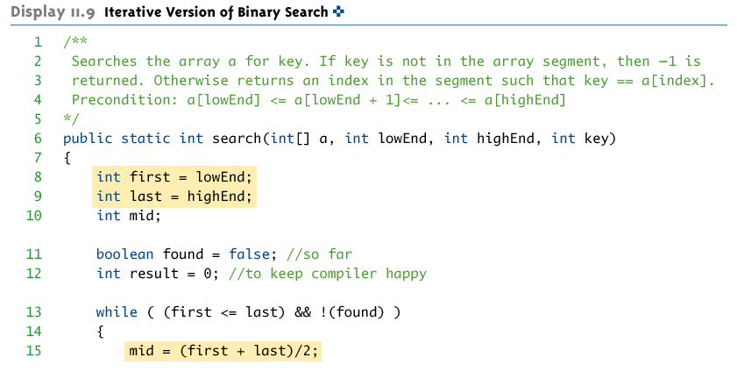
Iterative Version of Binary Search

Slide 22
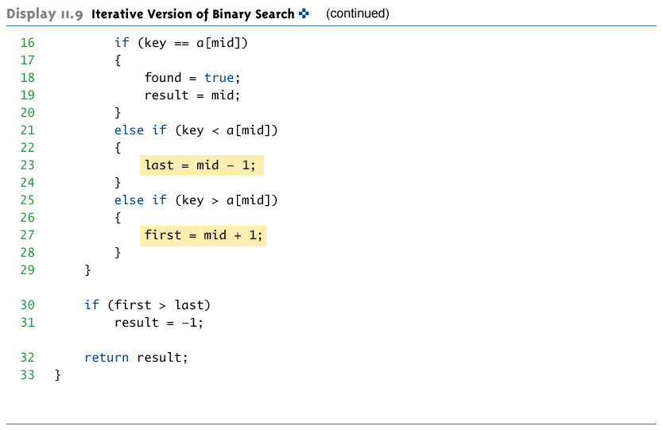
Iterative Version of Binary Search

Slide 23
Outlook
Next week, we’ll discuss basic sorting algorithms

